Slide 1

Search & Sort
CISC 610
Data Structures

Slide 2
What are we doing today?
Search
Traditional Linear Search
Ordered Linear Search
Binary Search
Interpolation Search
Sort
Bubble Sort
Selection Sort
Insertion Sort
Merge Sort
Quicksort

Slide 3
A Quick Note
“Search & Sort” sounds very absolute
These algorithms are MEGA useful but not absolute
Used on/useful for linear data structure that allow arbitrary elements to be accessed
Searching or sorting a stack or queue goes against the main design of those data types
Searching a tree has specific algorithms that will be covered when we cover trees
These algorithms will primarily be used on arrays, dynamic arrays, or linked lists
With that said…

Slide 4
Search!
One of the most elemental types of algorithm in CS
Being able to find where/if something exists in memory is crucial
The goal of each of these searches is to find an index or an item within a list or array
Item type is arbitrary as long as the searched and searched for items are comparable
May or may not find the first instance of the item, depending on the search algorithm
The search may not find the item if it doesn’t exist in the list
What happens in this case is implementation specific

Slide 5
Traditional Linear Search
(Also may hear this called “Sequential Search”)
Described as “start at one end and go until you find the item”
Algorithm:
Start at index 0 For each element in the list If the current element is the searched item Return the current index Else, increment the current index Return the failure state
Example?

Slide 6
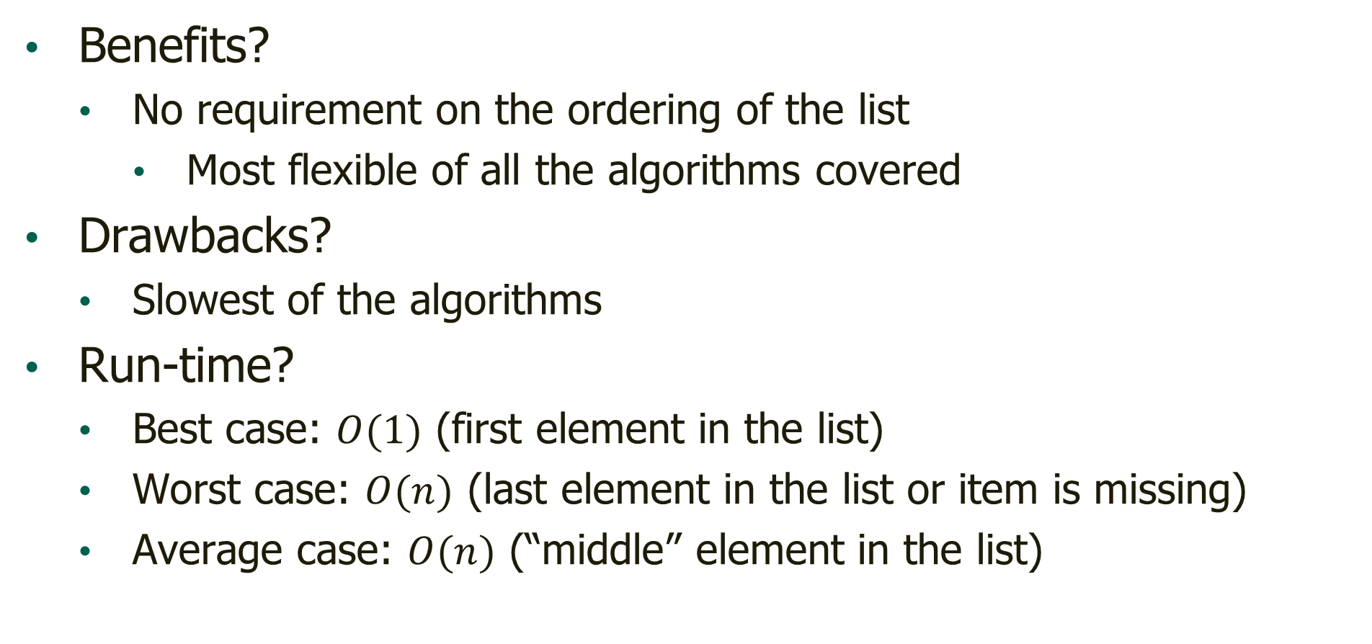
Traditional Linear Search Analysis
Benefits?
No requirement on the ordering of the list
Most flexible of all the algorithms covered
Drawbacks?
Slowest of the algorithms
Run-time?
Best case: $O(1)$ (first element in the list)
Worst case: $O(n)$ (last element in the list or item is missing)
Average case: $O(n)$ (“middle” element in the list)

Slide 7
Ordered Linear Search
An optimization of the linear search
If we have an ordered list, we can use this metadata to determine if the element could still exist in the list
Algorithm:
Start at index 0 For each element in the list If the current element is the searched item Return the current index Else if the current element “passes” the searched item Return the failure state Else, increment the current index
Example?

Slide 8
Ordered Linear Search
“Passes?”
Book describes the algorithm assuming a “low to high” ordering
Ordered linear search can work with low to high or high to low orderings
If low to high, we would check to see if the current element is greater than the searched item
If it is, this means that we passed where the item should be
If high to low, we would check to see if the current element is less than the searched item
We will generally assume “low to high” going forward unless noted

Slide 9
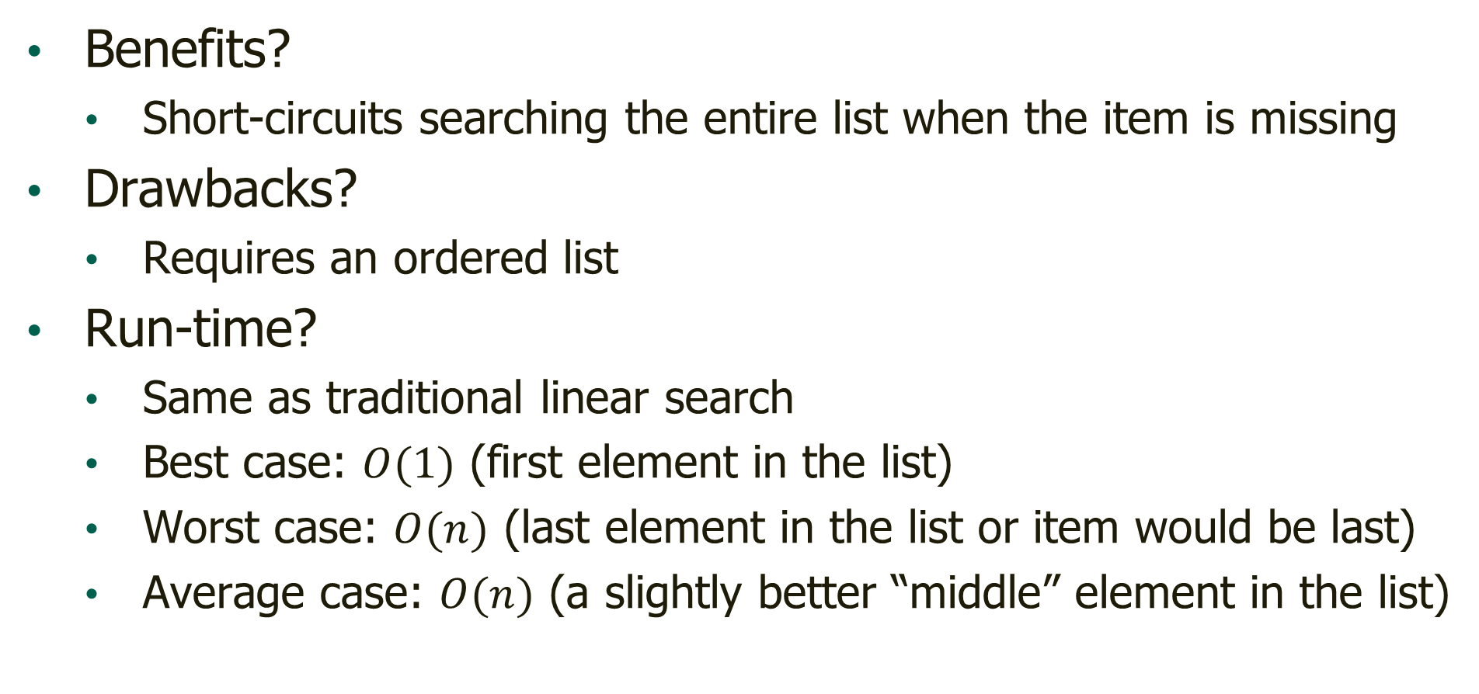
Ordered Linear Search Analysis
Benefits?
Short-circuits searching the entire list when the item is missing
Drawbacks?
Requires an ordered list
Run-time?
Same as traditional linear search
Best case: $O(1)$ (first element in the list)
Worst case: $O(n)$ (last element in the list or item would be last)
Average case: $O(n)$ (a slightly better “middle” element in the list)

Slide 10
Binary Search
The “guess a number from 1 to 100 game”
If we have an ordered list, we can use this metadata to efficiently search the list with a “divide and conquer” strategy

Slide 11
Binary Search
Algorithm:
Set the min index = 0, max index = array len Set current index = max index // 2 While min index <= max index If the current element is the searched item Return the current index Else if the current element < searched item Set max index = current index - 1 Else, the current element > searched item Set min index = current index + 1 Set current index to average of min and max index Return the failure state
Example?

Slide 12
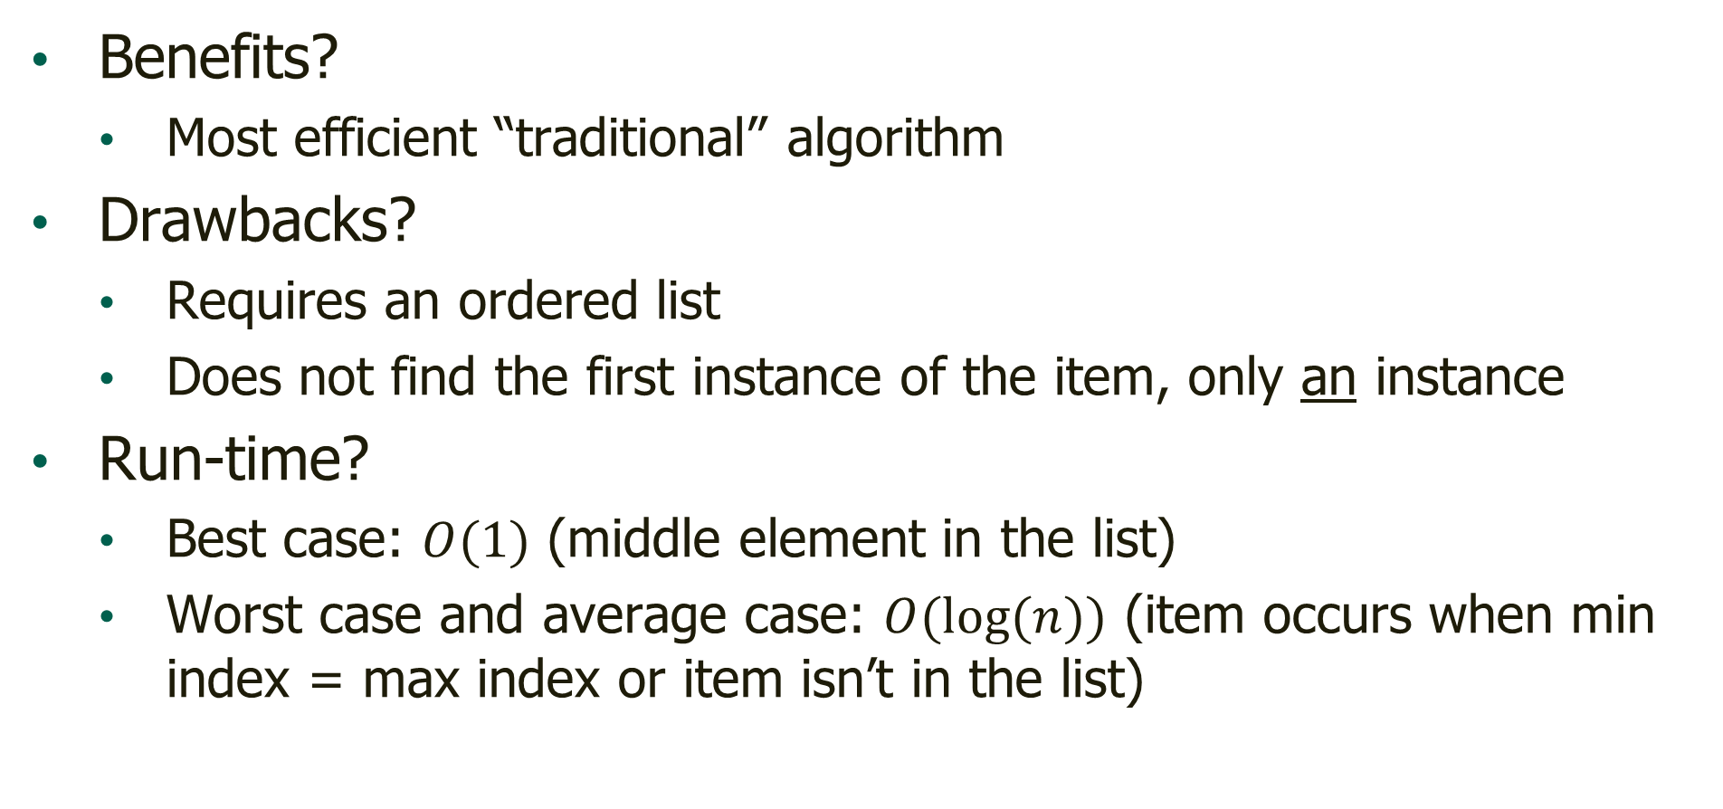
Binary Search Analysis
Benefits?
Most efficient “traditional” algorithm
Drawbacks?
Requires an ordered list
Does not find the first instance of the item, only an instance
Run-time?
Best case: $O(1)$ (middle element in the list)
Worst case and average case: $O(\log{(n)})$ (item occurs when min index = max index or item isn’t in the list)

Slide 13
Binary Search Analysis
Wait…are you saying that the average and worst case are the same?
Yes! Not “equivalent run times” but literally the same instance
Imagine a tree where the top element (root) is your first guess
Next draw paths (branches) down to the left and the right
On left branch, write your second guess if the first was high
On right branch, write your second guess if the first was low
Continue until all elements are in the tree
Like this…

Slide 14
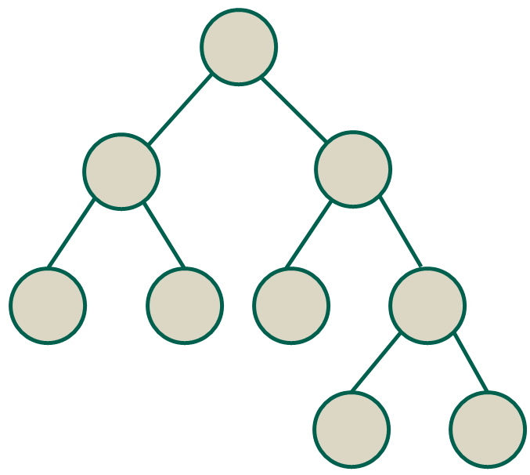
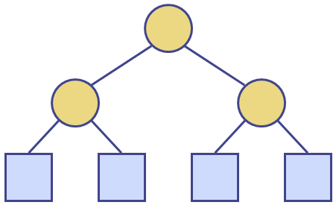
Binary Search Analysis
Wait…are you saying that the average and worst case are the same?
How many elements are in the bottom level versus the rest of the tree?
Since there are as many elements on the bottom level as the rest of the tree, the average position would be the bottom level

Slide 15
Interpolation Search
An improvement on binary search
Still requires an ordered list
Instead of searching blindly by position like binary search, interpolation search uses the values at the high and low index to estimate where in the remaining search space to go next
Mimics how people search through a book for a page number
(Book uses the example of searching a phone book)
(Have any of you ever used a phone book or know what it is?)
(I’m not trying to be rude, I’m genuinely curious…)

Slide 16
Interpolation Search
Algorithm is the same as binary search except current index is calculated as:
min_index + floor of: ( ( ( max_index - min_index ) / ( input_list[max_index] - input_list[min_index] ) ) * ( search_value - input_list[min_index] ) )
We are prorating based on the number of slots, the range of values in those slots extreme slots, and our searched item
Example?

Slide 17
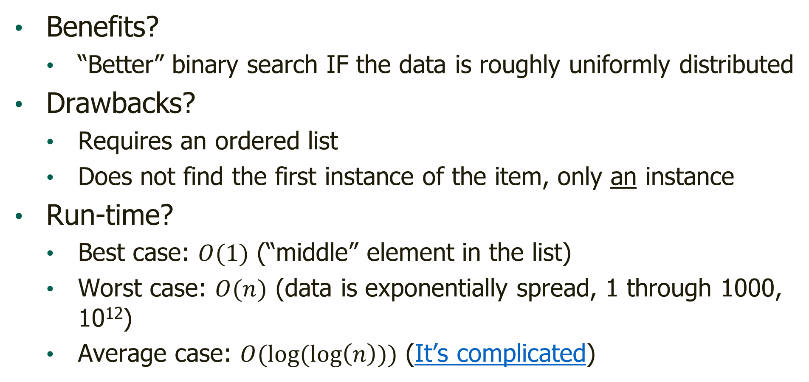
Interpolation Search Analysis
Benefits?
“Better” binary search IF the data is roughly uniformly distributed
Drawbacks?
Requires an ordered list
Does not find the first instance of the item, only an instance
Run-time?
Best case: $O(1)$ (“middle” element in the list)
Worst case: $O(n)$ (data is exponentially spread, 1 through 1000, 10¹²)
Average case: $O(log⁡(\log\left(n\right)))$ (It’s complicated)

Slide 18
Search, in Summary
When should I use what?
Traditional linear search is the most generic, least efficient, but simplest to implement and always works
All other searches require knowing that the list is ordered to work
Ordered linear search could be a simple, parameterized optimization if you know you’ll need traditional linear search most of the time but might sometimes have an ordered list
Binary search is great if you have an ordered list but don’t know if the data is uniformly distributed
Interpolation search is great if the data is typically uniformly distributed throughout the list

Slide 19
Sort!
As we just saw, having a sorted list is really beneficial
If we can sort really efficiently, we can use far more effective and efficient algorithms for our other purposes
(Or, worst case, we consolidate some of our run time inefficiency into a single, known point that we can offload to less computationally intensive times)
All of these sorting algorithms can be used to sort any linear list from low-to-high or high-to-low
We will present the low-to-high version here
(Visualizations presented are taken from here)

Slide 20

Bubble Sort
Bubble the largest value to the end of the list with each pass
If two adjacent elements are in the wrong order, swap them
Continue to process the whole list until no swaps are made during the current pass
(Can be minorly optimized by tracking the current “beginning” of sorted content)
The following visualization uses this optimization
Each row of the image is its own data set being sorted by wavelength

Slide 21
Bubble Sort
Algorithm:
Set sorted flag to false While the list is not sorted Set the sorted flag to true, current index to 0 For each pair of adjacent elements in the list If the current element > the next element Swap elements Set the sorted flag to false Increment the current index
Example?

Slide 22
Bubble Sort Analysis
Benefits?
Oh…um…well, this is awkward
(I swear this has never happened to me before)
Easily detects when the list is sorted
Maybe it’s simple to implement?
(In my opinion, it’s not really any easier than the next two)
Drawbacks?
Reliably the slowest, all-purpose sort algorithm
As mentioned, can be optimized slightly but still reliably slow
If I’m being honest, this is just a teaching tool

Slide 23
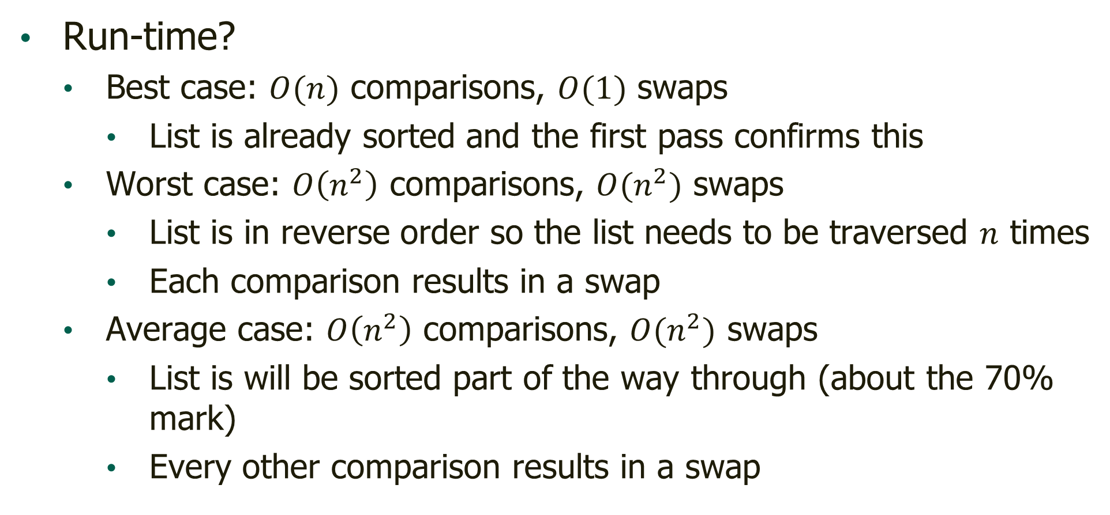
Bubble Sort Analysis
Run-time?
Best case: $O(n)$ comparisons, $O(1)$ swaps
List is already sorted and the first pass confirms this
Worst case: $O\left(n^{2}\right)$ comparisons, $O(n^{2})$ swaps
List is in reverse order so the list needs to be traversed $n$ times
Each comparison results in a swap
Average case: $O\left(n^{2}\right)$ comparisons, $O(n^{2})$ swaps
List is will be sorted part of the way through (about the 70% mark)
Every other comparison results in a swap

Slide 24
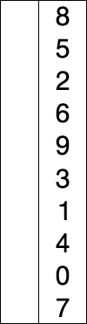
Selection Sort
Place the smallest remaining element at the lowest unsorted spot
When the smallest element is found, that element is swapped with the currently lowest index
Sorts in-place like bubble sort, so we don’t need a new list
(Animation from Wikipedia)

Slide 25
Selection Sort
Algorithm:
For each index in the list Set the smallest index to the current index For each index after the current index If the current element < the smallest element Set the smallest index to the current index Swap the current and the smallest element Example?

Slide 26
Selection Sort Analysis
Benefits?
VERY simple to implement
Follows how people sort things that they get all at once
If anyone plays cards, probably how you sort your cards if you pick up your entire hand at the same time
Drawbacks?
Still reliably and relatively slow
No real shortcutting
Even if the list sorted, you have to confirm each element is where it belongs

Slide 27
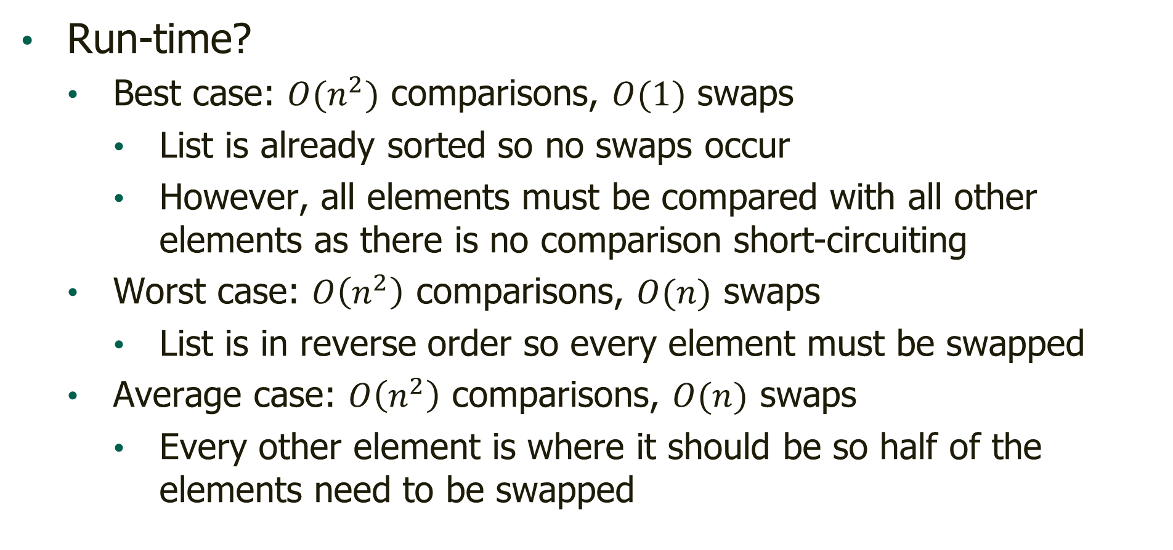
Selection Sort Analysis
Run-time?
Best case: $O(n^{2})$ comparisons, $O(1)$ swaps
List is already sorted so no swaps occur
However, all elements must be compared with all other elements as there is no comparison short-circuiting
Worst case: $O\left(n^{2}\right)$ comparisons, $O(n)$ swaps
List is in reverse order so every element must be swapped
Average case: $O\left(n^{2}\right)$ comparisons, $O(n)$ swaps
Every other element is where it should be so half of the elements need to be swapped

Slide 28

Insertion Sort
Sorts by sorting a series of incrementally increasing in size sublists
Start with a sublist of the first two elements and sort that
Then, increase to a sublist of three elements
What does this means
The third element just needs to be placed into the proper position among the first two
Continue with the fourth and so on until complete
In-place and combines approaches of bubble and selection sort
Can stop early sorted lists but only swaps each element once

Slide 29
Insertion Sort
Algorithm:
For each index to place in the list, starting with 1 Set the index to search as the index to place – 1 While index to search >= 0 and the element to place < element to search Decrement the index to search If the index to place is not the index to search + 1 Insert the element at the index to place in after of the current index to place
(Note that the insertion implies potentially shifting all previous data down)
Example?

Slide 30
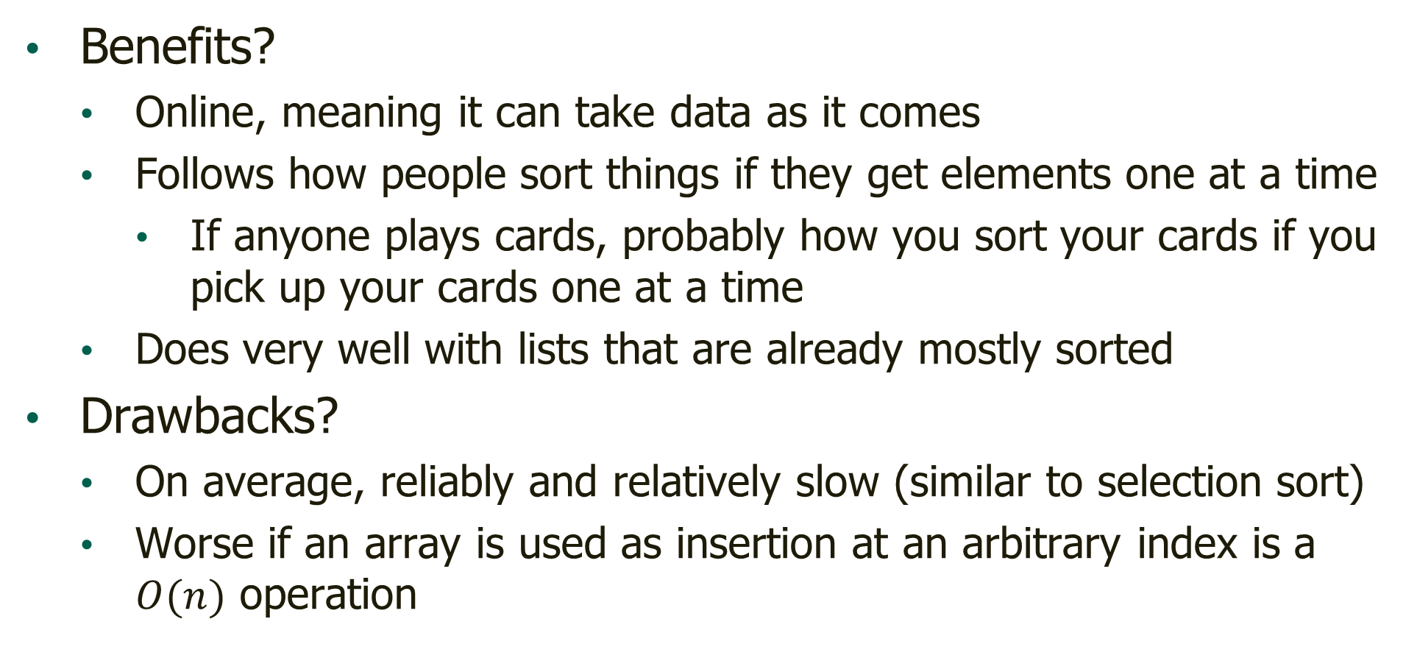
Insertion Sort Analysis
Benefits?
Online, meaning it can take data as it comes
Follows how people sort things if they get elements one at a time
If anyone plays cards, probably how you sort your cards if you pick up your cards one at a time
Does very well with lists that are already mostly sorted
Drawbacks?
On average, reliably and relatively slow (similar to selection sort)
Worse if an array is used as insertion at an arbitrary index is a $O(n)$ operation

Slide 31
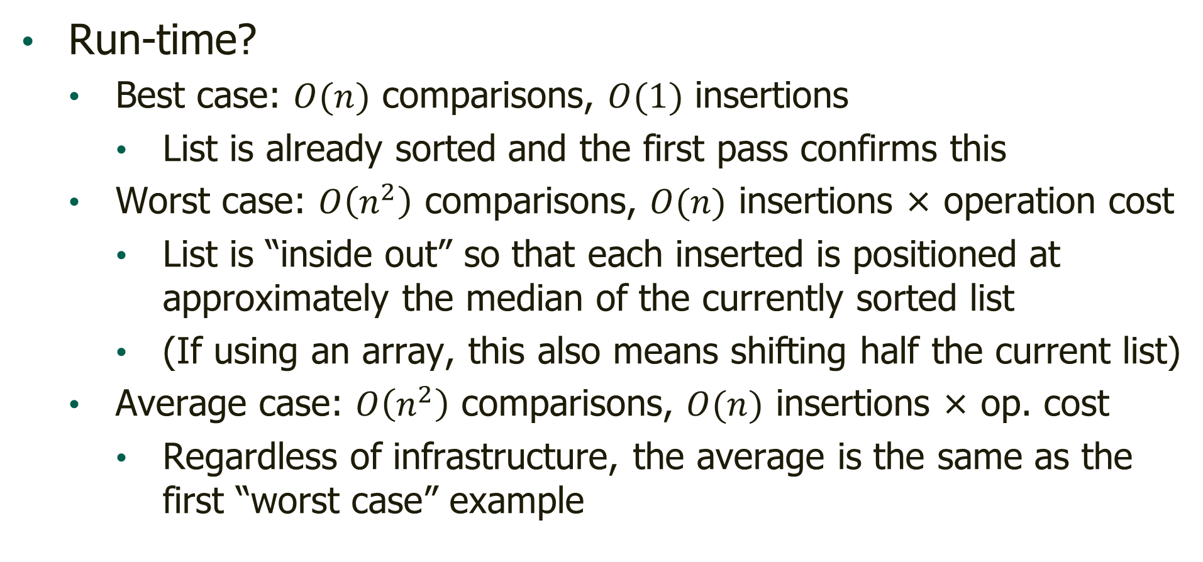
Insertion Sort Analysis
Run-time?
Best case: $O(n)$ comparisons, $O(1)$ insertions
List is already sorted and the first pass confirms this
Worst case: $O\left(n^{2}\right)$ comparisons, $O(n)$ insertions × operation cost
List is “inside out” so that each inserted is positioned at approximately the median of the currently sorted list
(If using an array, this also means shifting half the current list)
Average case: $O\left(n^{2}\right)$ comparisons, $O(n)$ insertions × op. cost
Regardless of infrastructure, the average is the same as the first “worst case” example

Slide 32

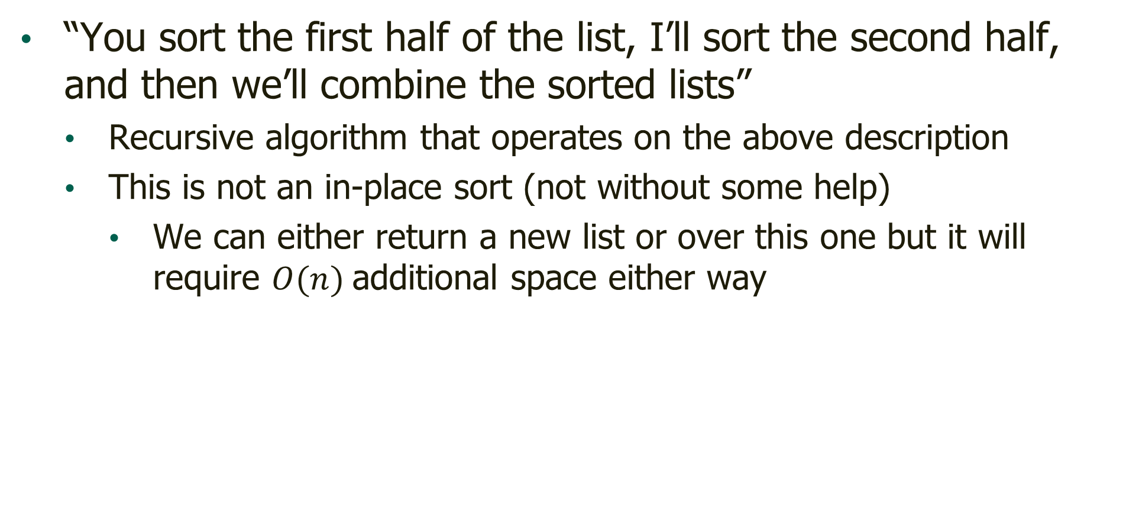
Merge Sort
“You sort the first half of the list, I’ll sort the second half, and then we’ll combine the sorted lists”
Recursive algorithm that operates on the above description
This is not an in-place sort (not without some help)
We can either return a new list or over this one but it will require $O(n)$additional space either way

Slide 33
Merge Sort
Algorithm for MergeSort(data, start, end):
If our range of elements is more than 1 element Set middle to average of start and end Merge Sort the data from the start to the middle Merge Sort the data from the middle + 1 to the end Merge(data, start, end)

Slide 34
Merge Sort
Algorithm for Merge(data, start, middle, end):
Create a new list of length (end – start + 1) Set 1st index to start, 2nd index to middle + 1 For each index in the new list If 1st index <= middle and 1st element <= 2nd element Copy 1st element to the next position in new list Else Copy 2nd element to the next position in new list Copy the new list back onto data starting at start index
Example?

Slide 35
Merge Sort Analysis
Benefits?
Efficient (due to the divide and conquer nature)
In fact, could be considered the most consistently efficient general-purpose sorting algorithm
Typically a stable sort
Equivalent elements remain in order during sort
Drawbacks?
Done with recursion so there is overhead

Slide 36
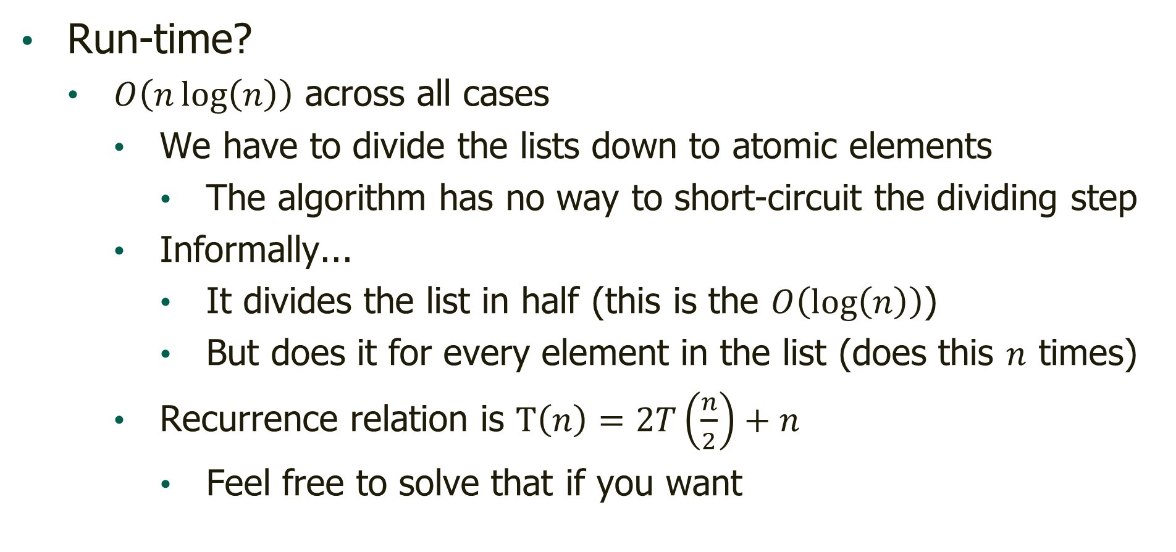
Merge Sort Analysis
Run-time?
$O\left(n\log\left(n\right)\right)$ across all cases
We have to divide the lists down to atomic elements
The algorithm has no way to short-circuit the dividing step
Informally...
It divides the list in half (this is the $O\left(\log\left(n\right)\right)$)
But does it for every element in the list (does this $n$ times)
Recurrence relation is $T\left(n\right)=2T\left(\frac{n}{2}\right)+n$
Feel free to solve that if you want

Slide 37

Quicksort
Pick a spot in the list and make sure everything smaller is on one side of that spot and everything bigger is on the other side
Also sometimes called partition-exchange
The “pivot” is the element at each step that the other elements are organized around
Data doesn’t literally pivot around this index, rather the data is reorganized within the list so that the pivot is between groups

Slide 38
Quicksort
Algorithm for Quicksort(data, start, end):
If our range of elements is more than 1 element pivot index = Partition(data, start, end) Quicksort the data from the start to the pivot - 1 Quicksort the data from the pivot + 1 to the end

Slide 39
Quicksort
Algorithm for Partition(data, start, end):
Set the pivot value to the end element Set the swap index to start For each index between start and end If the current element < pivot value Swap the current element and the swap element Increment the swap index Swap the swap element with the end element Return the swap index
Example?

Slide 40
Quicksort Analysis
Benefits?
Efficient (due to the divide and conquer nature)
At it’s fastest, it’s marginally faster than merge sort
There’s no need to copy the data back in Merge(…)
Can be done in-place, reducing memory needs
Drawbacks?
Done with recursion so there is overhead
Rarely will be faster than merge sort
Can be as slow as selection sort in the worst case

Slide 41
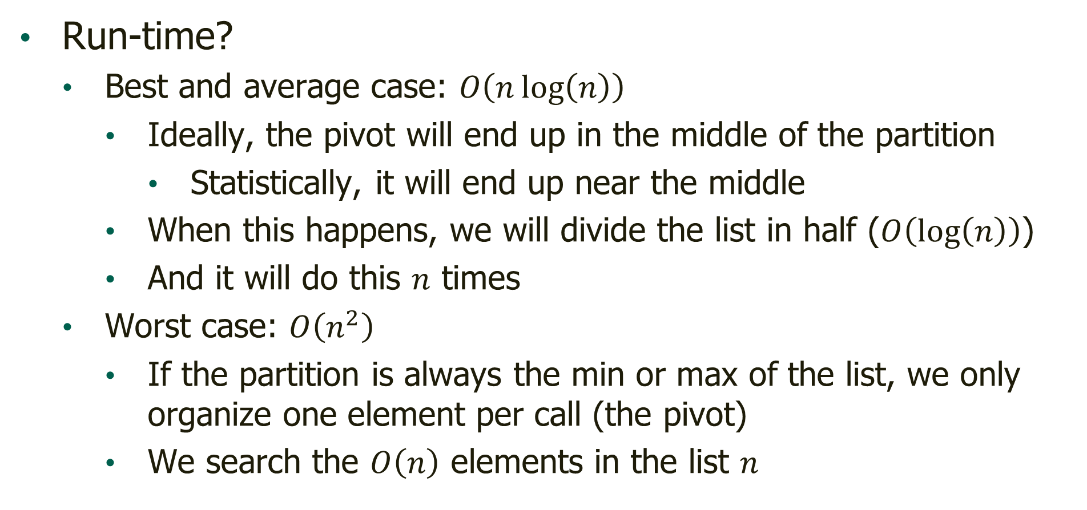
Quicksort Analysis
Run-time?
Best and average case: $O\left(n\log\left(n\right)\right)$
Ideally, the pivot will end up in the middle of the partition
Statistically, it will end up near the middle
When this happens, we will divide the list in half ($O\left(\log\left(n\right)\right)$)
And it will do this $n$ times
Worst case: $O\left(n^{2}\right)$
If the partition is always the min or max of the list, we only organize one element per call (the pivot)
We search the $O\left(n\right)$ elements in the list $n$

Slide 42

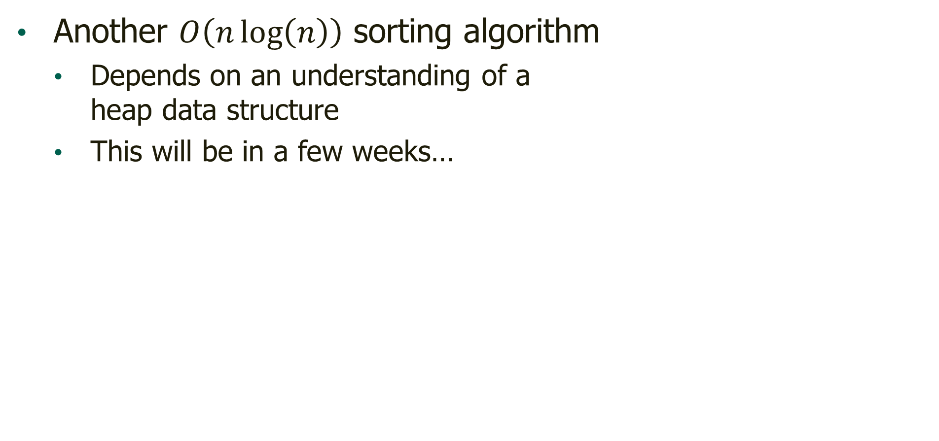
Heap Sort
Another $O\left(n\log\left(n\right)\right)$ sorting algorithm
Depends on an understanding of a heap data structure
This will be in a few weeks…

Slide 43
Questions?

